Slide 1

BATCH IN 2019

Slide 2

2019!

Slide 3

ANY REPLICANTS?

Slide 4


HOVERBOARDS OR FLYING CARS?

Slide 5
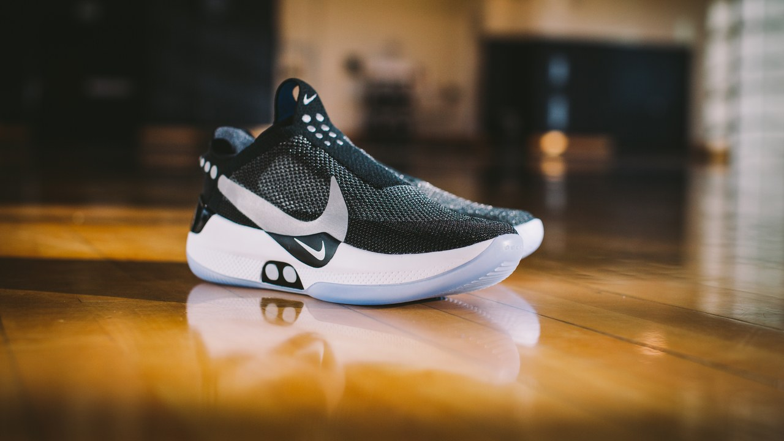
SELF LACING SHOES!

Slide 6
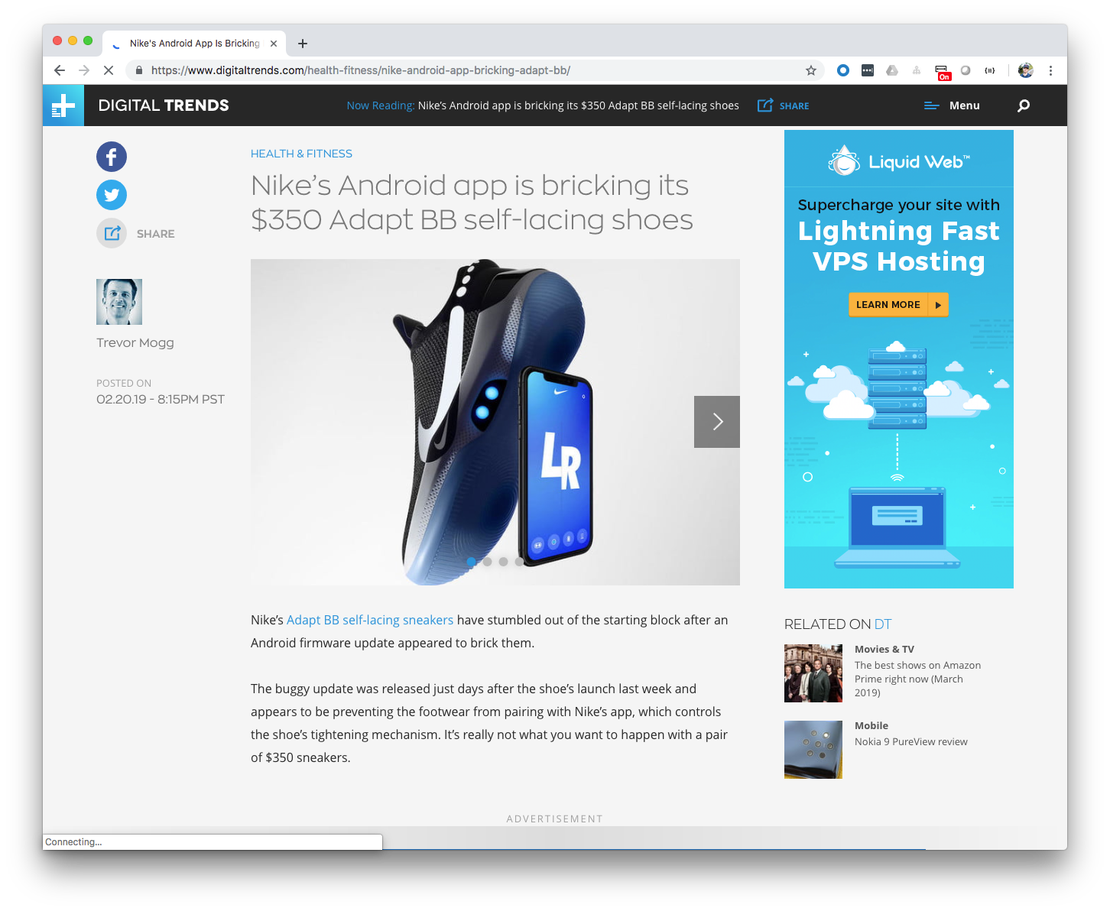

Slide 7

ALL THESE AMAZING THINGS
THE FUTURE HAS BROUGHT US…

Slide 8


Slide 9


MICHAEL MINELLA
Lead – Spring Batch &
Spring Cloud Task
JSR-352 - Expert Group Member
Author – Pro Spring Batch
The D G to Spring Batch
Speaker - JavaOne Rockstar
Java Champion
Podcast - OffHeap Curmudgeon
Twitter - @michaelminella or
@OffHeap

Slide 10

COMING THIS SUMMER!
https://www.apress.com/us/book/9781484237236

Slide 11

SLIDES AND CODE
ARE ON GITHUB
https://github.com/mminella/Batch-In-2019
Notes:
S1P 2018 branch was used in the presentation at Spring One Platform 2018

Slide 12

Notes:
Please ask questions when you have them

Slide 13


LAY OF THE LAND

Slide 14

SPRING FRAMEWORK

Slide 15
SPRING BATCH

Slide 16

SPRING CLOUD DATA FLOW

Slide 17

MICROMETER

Slide 18

PROMETHEUS

Slide 19

GRAFANA

Slide 20
¯\_(ツ)_/¯

Slide 21

DAY IN THE LIFE OF
A BATCH DEVELOPER

Slide 22

GET OUR COFFEE

Slide 23

CHECK THE STATUS
OF THE EXISTING JOBS

Slide 24

ADD A NEW FEATURE

Slide 25

GO TO
PRODUCTION!

Slide 26

CHECK THE STATUS
OF THE EXISTING JOBS

Slide 27



Spring Batch/Spring Cloud Task
Push Gateway
Prometheus
Grafana
Spring Cloud Data Flow

Slide 28

ADD A NEW FEATURE

Slide 29
Step1
Step2
ItemReader
ItemProcessor
Tasklet
ItemWriter

Slide 30

GO TO
PRODUCTION!

Slide 31
Github
CircleCI
Spring Cloud Data Flow
Maven Repository

Slide 32
Monitor the new feature

Slide 33

LOOKING AHEAD

Slide 34
SPRING BATCH 4.1.1.RELEASE

Slide 35
SPRING BATCH 4.2.0.M1

Slide 36
SPRING BATCH 4.2.0.RELEASE

Slide 37

PERFORMANCE

Slide 38
METRICS VIA
MICROMETER

Slide 39
SPRING CLOUD DATA FLOW 2.0!

Slide 40
ANALYTICS VIA
MICROMETER
Notes:
Apps have support for Prometheus, InfluxDB, and Data Dog

Slide 41
REVAMPED METRICS
VIA MICROMETER

Slide 42

SECURITY
IMPROVEMENTS

Slide 43

DASHBOARD
IMPROVEMENTS

Slide 44
DATABASE MIGRATION
SUPPORT

Slide 45

MULTIFOUNDATION
SUPPORT FOR TASKS

